Slide 1



Machine Learning-Based Credit Risk Prediction with Safe Loan Amount and EMI Recommendation
22CSP72-PROJECT WORK II PHASE II
Third Review
Team Members:
NAVEEN SRINIVAS V(23CSR145)
MENAHA R(23CSR130)
RITHISH R (23CSR178)
Mentor Name:
Dr. M GEETHA (Associate Professor)
Date:12.10.2026

Slide 2
Problem Statement
Existing Problem
Banks use manual checking or simple rules to evaluate loan applications.
This process takes more time and can lead to incorrect decisions.
Risky customers may be approved, while eligible customers may be rejected.
Proposed Solution:
Use Machine Learning to classify customers as Safe or Risky.
Generate a Risk Score and recommend a suitable Loan Amount and EMI.
Provide clear reasons for the prediction to support accurate loan decisions.

Slide 3
Objectives
Develop machine learning models to predict customer loan default risk.
Collect and preprocess loan and customer financial data.
Train and implement Random Forest, XGBoost, LightGBM, Logistic Regression, and Gradient Boosting models.
Compare model performance using accuracy, precision, recall, F1-score, and ROC-AUC.
Identify the best-performing model for loan default risk prediction.
Provide safe loan amount and EMI recommendations based on the borrower's repayment capacity.

Slide 4
Literature Survey
Author & Year | Methodology | Performance | Limitation
ML-Based Credit Scoring Models (2024) | Logistic Regression, Random Forest, XGBoost | 85–92% Accuracy | Low explainability
Credit Risk Prediction Using ML (2024) | Support Vector Machine, Random Forest | AUC 0.88 | No loan recommendation
Explainable AI for Loan Approval (2025) | XGBoost, SHAP | 90%+ Accuracy | Limited real-time use
Banking Risk Analysis Using ML (2024) | Logistic Regression, Neural Network | 87–91% Accuracy | No EMI recommendation
Hybrid Loan Default Prediction (2025) | XGBoost, SHAP, Topological Data Analysis | ROC-AUC 0.973 | Limited to maritime finance

Slide 5
Research Gap
Most existing studies only predict whether a customer will repay the loan or not.
They do not recommend a suitable loan amount or EMI based on the customer's financial condition.
Many models focus only on improving accuracy and provide limited explanation for their predictions.
There is a need for a user-friendly system that combines risk prediction, risk score, loan recommendation, and explainable results in one platform.

Slide 6
Research Flow
Problem Identification
↓
Literature Survey
↓
Research Gap Identification
↓
Dataset Collection
↓
Data Preprocessing
↓
Feature Engineering
↓
Random Forest, XGBoost, LightGBM, Logistic Regression, and Gradient Boosting Model Training
↓
Model Performance Evaluation
↓
Credit Risk Prediction & Risk Score Generation
↓
SHAP-Based Explainability
↓
Safe Loan Amount Recommendation
↓
Personalized EMI Recommendation
↓
Real-Time Web Application Integration
↓
Result Analysis

Slide 7
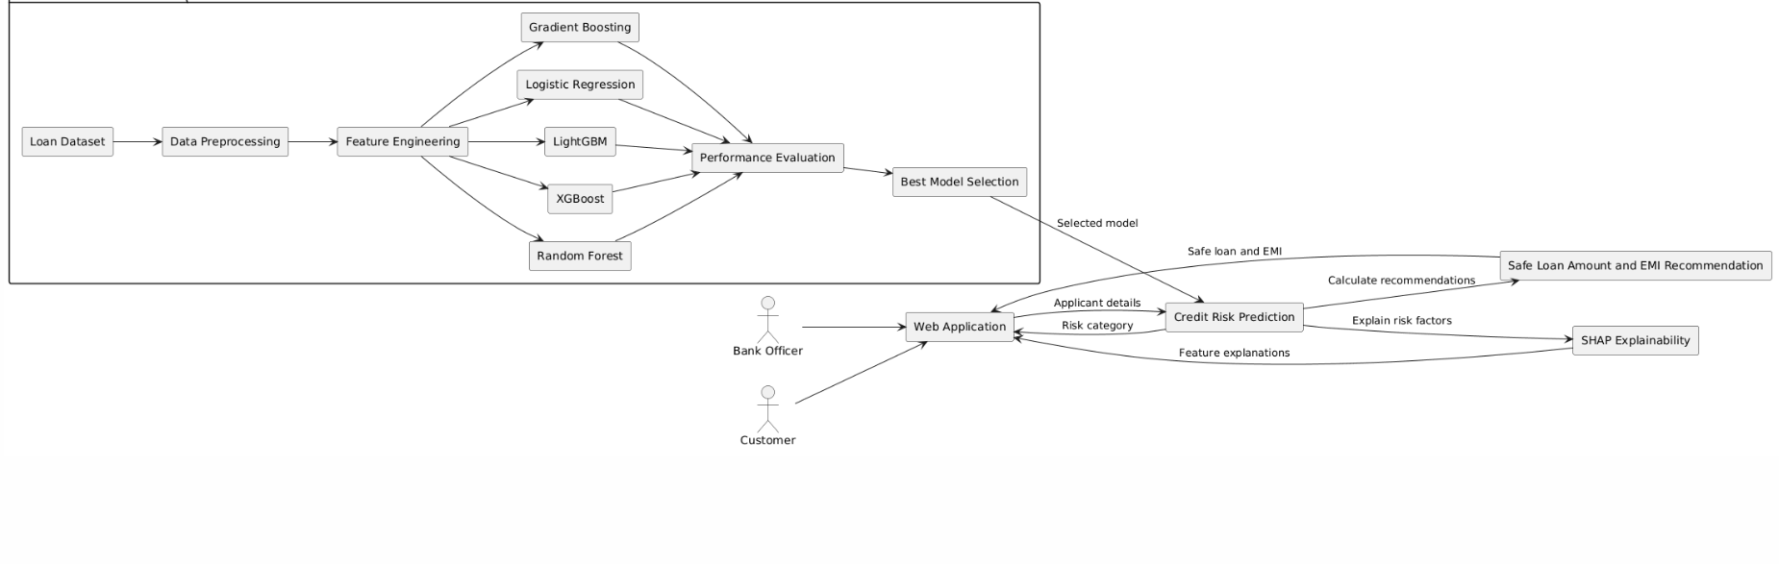
Architecture Diagram
Machine Learning-Based Credit Risk Prediction System

Slide 8
Proposed Work with Planned Innovation
Planned Innovation
Develop an Explainable AI system using SHAP to explain loan prediction results.
Predict customer credit risk using machine learning algorithms.
Recommend a safe loan amount based on the customer's financial profile.
Suggest suitable EMI plans based on repayment capacity.
Develop a web application for real-time loan risk prediction.
Support loan decisions by considering risk, eligibility, and affordability.
Compare Random Forest, XGBoost, LightGBM, Logistic Regression, and Gradient Boosting models.
Evaluate model performance using accuracy, precision, recall, F1-score, and ROC-AUC to identify the best-performing model.
Apply hyperparameter tuning to improve model performance.

Slide 9
Modules of the project
Module 1 – Dataset
Module 2 – Data Preprocessing
Module 3 – Feature Engineering
Module 4 – Machine Learning Model Training
Module 5 – Credit Risk Prediction
Module 6 – SHAP Explainability
Module 7 – Loan Amount & EMI Recommendation
Module 8 – Web Application
Module 9 – Performance Evaluation
Module 10 – Result Analysis

Slide 10
Methodology
Loan Dataset
↓
Preprocessing
↓
Feature Engineering
↓
Random Forest,XGBoost Training, LightGBM, Logistic Regression, and Gradient Boosting models.
↓
Risk Prediction
↓
SHAP Analysis
↓
Loan & EMI Recommendation
↓
Performance Evaluation

Slide 11
Baseline Comparision
Feature | Baseline System | Our Proposed System
Risk Prediction | Default prediction only | Safe / Risky prediction
ML Models | Single model | Random Forest, XGBoost, LightGBM, Logistic Regression, and Gradient Boosting models
Evaluation | Limited | Multiple metrics
Risk Score | Not available | Risk score generation
Explainability | Limited | SHAP explainability
Loan Amount | Not available | Safe loan recommendation
EMI | Not available | Personalized EMI
Interface | Limited/Offline | Real-time web application
Decision Support | Prediction only | Risk and Eligibility

Slide 12
Complexity & Cost, Relevance to Environment,Sustainability
Complexity & Cost:
Our system automates loan risk analysis, reducing manual work and effort.
Relevance to Environment:
The web-based system reduces the need for paper-based loan processing.
Sustainability:
Our digital solution supports efficient, paperless, and long-term loan decision-making.

Slide 13
SDG Goals Mapping
SDG 1 – No Poverty: Helps users choose affordable loans and avoid excessive financial burden.
SDG 8 – Decent Work and Economic Growth: Improves efficient and responsible financial decision-making.
SDG 9 – Industry, Innovation and Infrastructure: Uses ML and web technology for innovative credit-risk assessment.
SDG 10 – Reduced Inequalities: Provides consistent, data-driven loan-risk evaluation.
SDG 12 – Responsible Consumption and Production:Supports environmentally friendly loan processing.

Slide 14
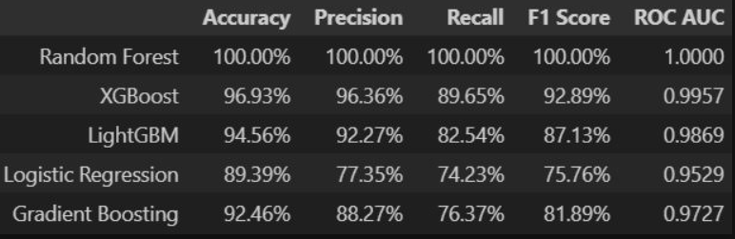
Implementation

Slide 15
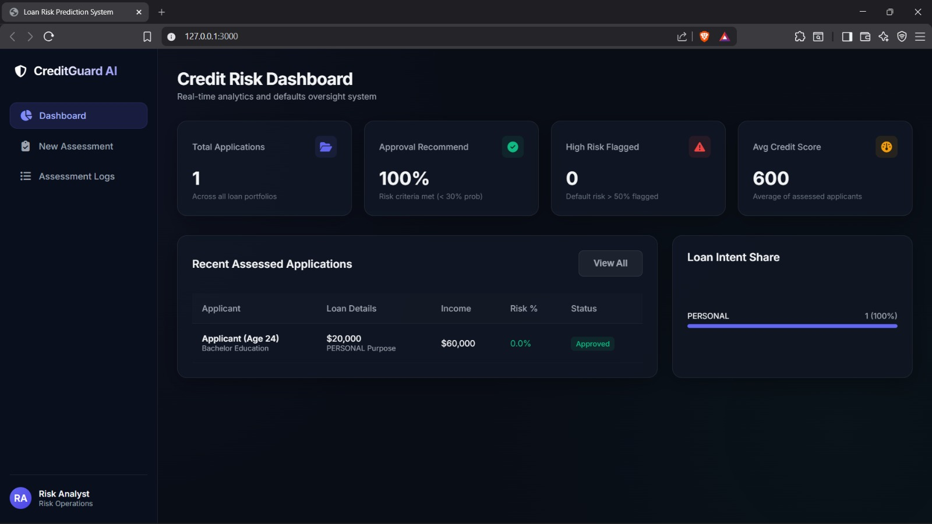

Slide 16
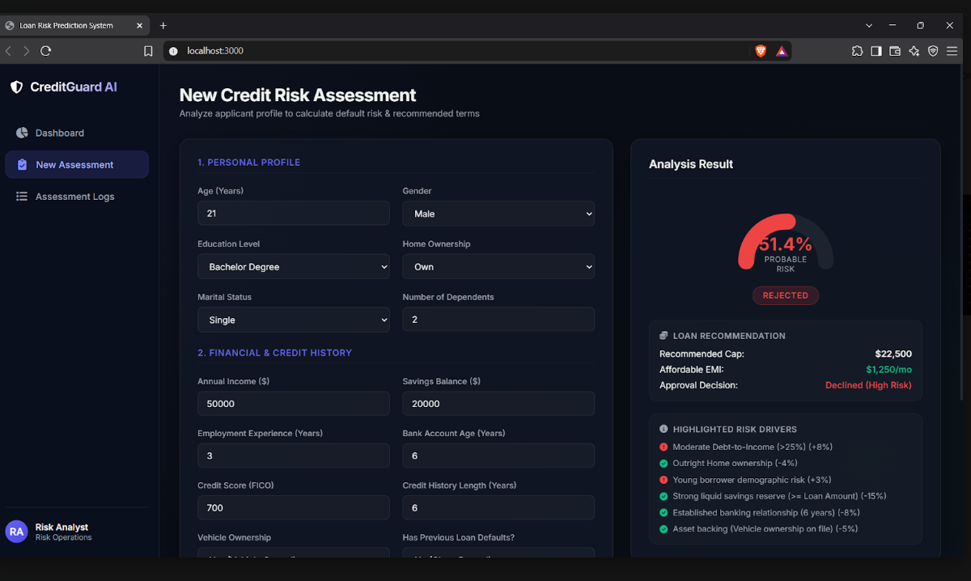

Slide 17
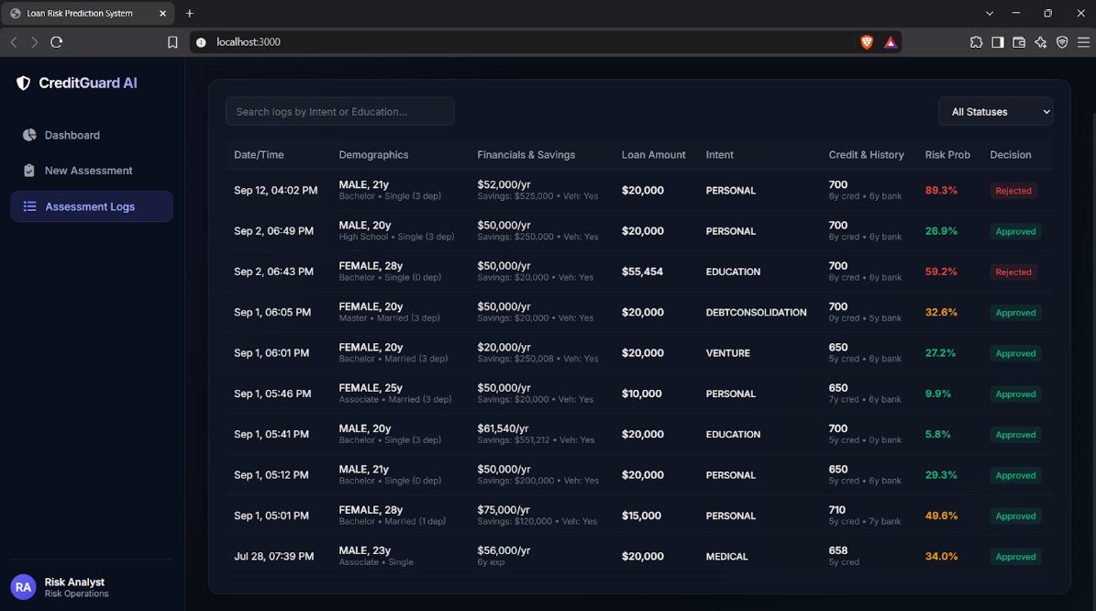

Slide 18
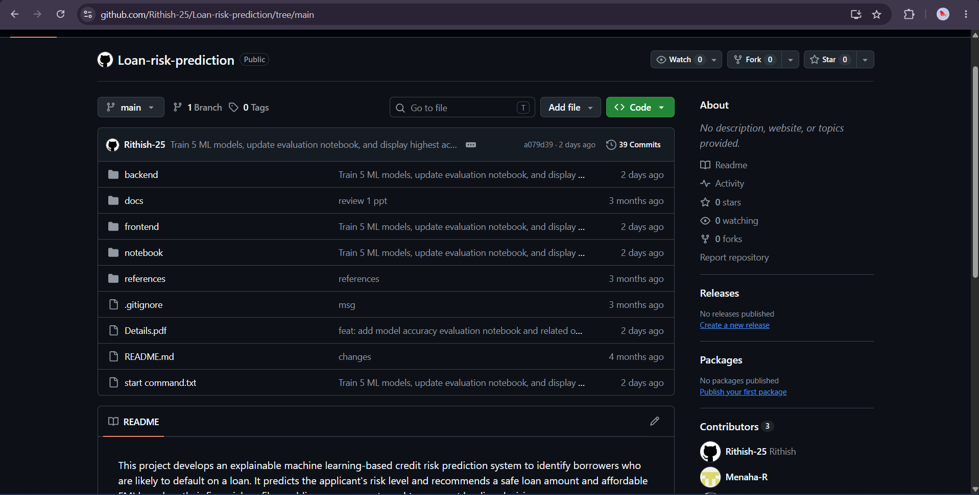
Git Documentation

Slide 19
THANK YOU

